Slide 1
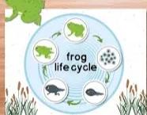
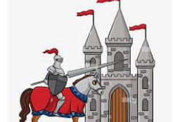
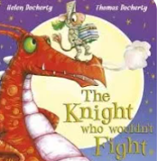

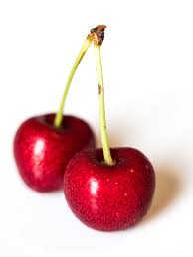
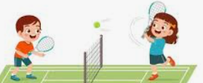
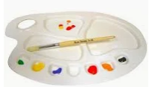
English
In English for the 1st half term the children will be writing animal stories based on The Little Red hen and That’s not my lion. Then for our topic Where in the world we will be writing about Handa’s Surprise. In the 2nd half term we will be focusing on knights and castles and we will be working on the books The Knight Who Wouldn’t Fight and In The Castle. We will then write some poetry about Knights .In phonics year 1 will be working within phase 5 sounds and Reception children will be working within phase 4. Their reading books will match the phonics levels that they are secure in.
Maths
In the Summer term year 1s will be working with Multiplication and Division, Fractions, Place Value within 100, Measurement of Money and Time. Reception children will looking at Twenty and Beyond, How Many More, Manipulation, Composition and Decomposition of Shapes, Sharing and Grouping, Visualiise, build and Map using patterns and create maps and Making Connections.
History/ Geography
In History we will focusing on Knights and Castles and learning about THE Battle of Hastings.
In Geography we will be learning all about the 7 Continents and 5 Oceans, The Desserts, and the North and South Poles.
Science
In science this term will be learning all about Animals including Humans. We will learn about life cycles, basic needs of animals and the need for healthy practices.
Cherry Class Summer
2026
Music
In music we will be focusing using our imagination when listening to music.
DT
The children will developing their skills in sewing by designing a pouch for a knight, creating a pattern and sewing the pieces together.
ART
In art we will be focusing on paper sculptures using a variety of skills to manipulate paper.
PE
The children will be working on developing their dance skills, Tennis and swimming skills and practice athletics ready for sports day.
RSHE
In RSHE we are going to be learning all about challenging ourselves, safe relationships and embracing the moment.
ICT
Year 1s will be developing our skills in creating music using a computer and programming animations..
Reception children will have opportunity to create programmes for the Beebots, to use simple paint programmes and to complete simple games on the computers and I-pads.
RE
The children will be learning about what Christians believe about Agape.

